Slide 1
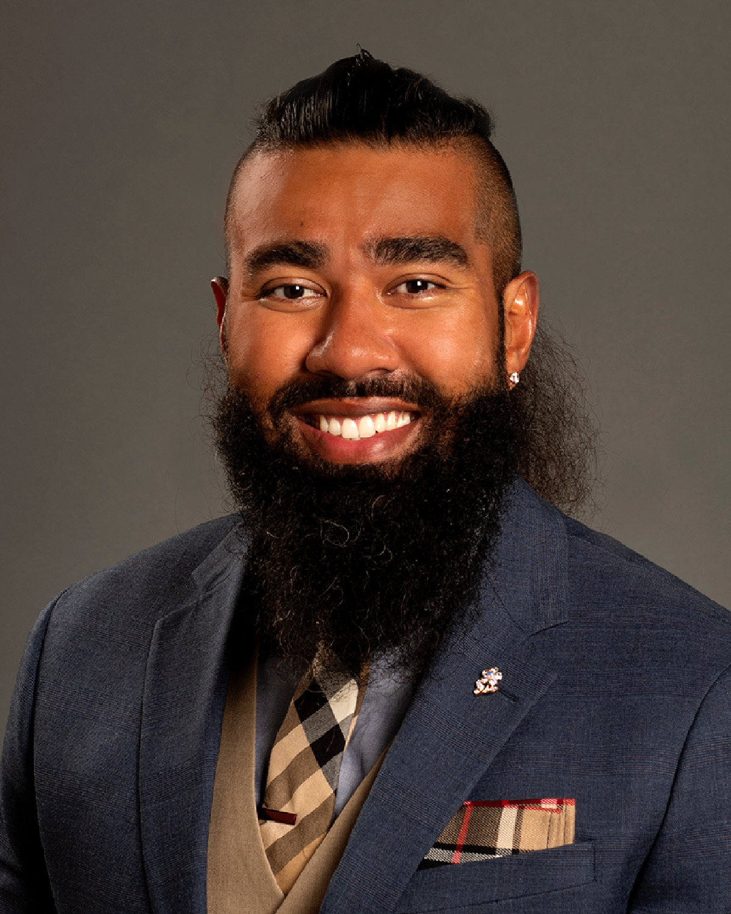


Safe Space v. Brave Space
By Your Name

Slide 2
Presenter Introduction
Upload a picture of yourself
Bullet point list of your professional and academic credentials

Slide 3
What is a safe space?
Bullet points detailing what a safe space is
Upload picture related to safe spaces

Slide 4
What is a brave space?
Upload picture related to brave spaces
Bullet points detailing what a brave space is

Slide 5
Safe Space Pros & Cons
Pros
Cons
Bullet point list of safe space pros
Bullet point list of safe space cons

Slide 6
Brave Space Pros & Cons
Pros
Cons
Bullet point list of brave space pros
Bullet point list of brave space cons

Slide 7
Persuade Your Audience
TO SEEK SAFE SPACES INSTEAD OF BRAVE SPACES
TO SEEK BRAVE SPACES INSTEAD OF SAFE SPACES
Bullet point list of why people should seek safe spaces instead of brave spaces
Bullet point list of why people should seek brave spaces instead of safe spaces

Slide 8
What are the similarities between safe spaces and brave spaces?
Bullet point list of similarities between safe spaces and brave spaces

Slide 9
What is your solution to the growing divide between safe space and brave space?
Bullet point list of proposed solutions

Slide 10
What (if anything) will you do
to create safe spaces?
To create brave spaces?
Bullet point list of what you will do to facilitate safe spaces for people
Bullet point list of what you will do to facilitate brave spaces

Slide 11
Self-Reflection
Bullet point list of personal reflections on this assignment and this course overall

Slide 12
Thank You
Bullet point list of your professional and academic credentials
Upload a picture of yourself

Slide 13
References
List of reference(s) in APA style

